Slide 1
Solar Storm
Environment

Slide 2
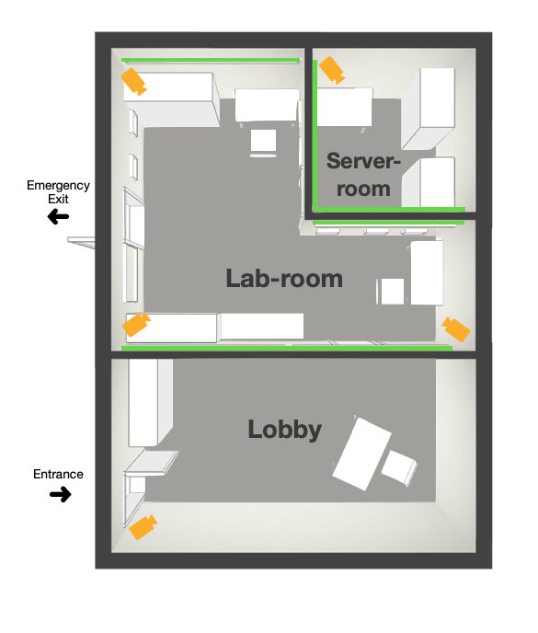
Rooms
Lobby Room
Control Room
Server Room
Control Room

Slide 3


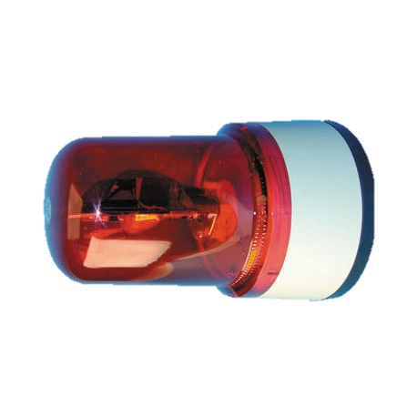
Lobby Room
Door to Control Room
Entry Door : Programmable magnetic lock
Logo – Backlights (Initially green/white, then red)
Speakers – for Announcement (recorded mp3)
Emergency lights – after announcement
Sudden power going off sound + glitch sounds in the BG
Puzzle 1 should open door to control room
Tablet/PC for hints
L
O
G
O
Puzzle 1

Slide 4
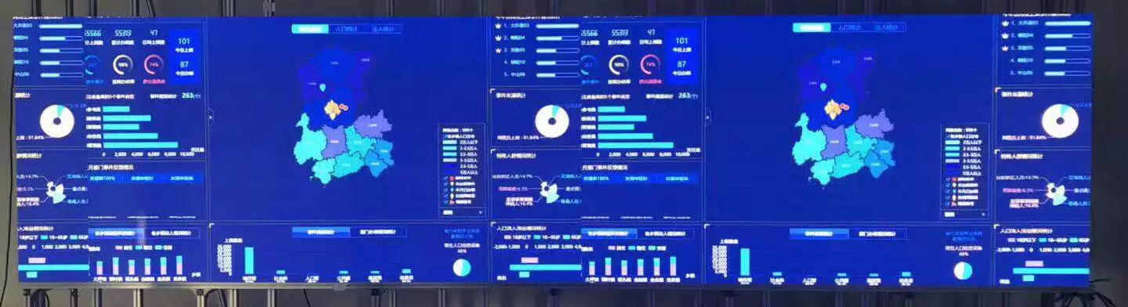
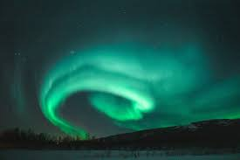


Control Room
Wallpaper/ Monitors
Projector to simulate aurora visuals through window
Spotlights for each puzzle
Buttons for Hints
Puzzle 4 opens door to Server room
Control Room

Slide 5
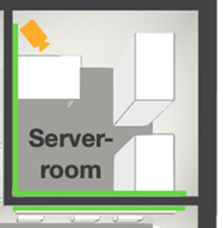
Server Room
Knock sensor on the door
Quote displayed with binary number (010 – for 2 knocks)
Play generator humming sound
Puzzle idea with Alexa

